Slide 1
Web Engineering
Web Application Security
Lecture 16

Slide 2
Steps to Make Your Website Secure
Keep All Software Updated
Build Layers of Security Around Your Site
Switch to HTTPS
Use Strong Passwords, Change Regularly
Apply Strong Authorization
Make Admin Directories Tough to Spot
Backup your Website
Make your Data Entry Secure via Captcha Code
Monitor your Website

Slide 3
Keep All Software Updated
Ensure that every piece of software you run is up to date.
CMS providers like WordPress, Joomla work round the clock trying to plug any holes in their systems and release regular patches and updates that make their software less vulnerable to attacks.
Ensure that you run these updates and have the latest version supporting your site at any given point in time.
If your site uses third party plugins, keep track of their updates and ensure that these are updated on time as well.
Clean out your website of any unused, old and non-updated plugins

Slide 4
Build Layers of Security Around Your Site
Just as you lock your doors before leaving your house and install antivirus software on your desktop computer, make your website secure.
A Web Application Firewall is that first line of defense. These solutions are designed to inspect incoming traffic, provide and weed out malicious requests –- offering protection from SPAM, brute force attacks, SQL Injections and Cross Site Scripting.

Slide 5
Build Layers of Security Around Your Site
Until just a few years ago, Web Application Firewalls were only available as hardware appliances, but today a few Security-as-a-service (SECaaS) providers are revolutionizing the industry by using cloud technology to cut down prices of security solutions previously found only in enterprise level setups.

Slide 6
Switch to HTTPS
HTTPS or Hyper Text Transfer Protocol Secure, is a secure communications protocol that is used to transfer sensitive information between a website and a web server.
Moving your website to the HTTPS protocol essentially means adding an encryption layer of TLS (Transport Layer Security) or SSL (Secure Sockets Layer) to your HTTP making your users’ and your own data extra secure from hacking attempts.

Slide 7
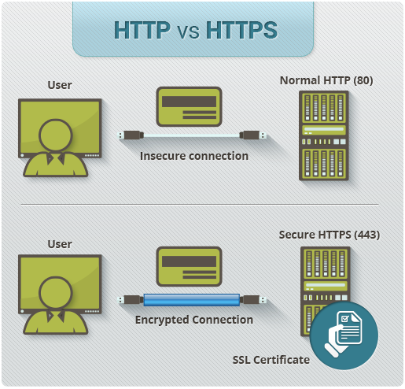

Slide 8
Use Strong Passwords, Change Regularly
Brute force attacks that try guessing username password combinations have multiplied at alarming rates over the last couple of years with thousands of attacks being detected on a daily basis across the web.
Using strong passwords is an effective way to limit if not completely eliminate brute force and dictionary attacks. Strong passwords are not just a requirement for your email or financial transactions online, they are also imperative for your website server, admin and database passwords.

Slide 9
Use Strong Passwords, Change Regularly
Make sure your password is a combination of alphanumeric characters, symbols, upper and lower case characters and is at least 12 characters long to prevent brute force attacks.
Do not use the same password for all your different website logins. Change your passwords regularly to keep them doubly secure.
Use Password Encryption
Store users’ passwords in encrypted form. This ensures that even if there is a security breach, attackers do not get their hands on actual user passwords.

Slide 10
Apply Strong Authorization
A filtering mechanism that allows access to the client or server environment only by those individuals with appropriate authorization codes(e.g., user ID and password)
For all the data or pages you want to access by some specific resources or users, do apply authentication via username/password so that a specific user can access his own area.

Slide 11
Make Admin Directories Tough to Spot
An ingenious way hackers gain access to your site’s data is by going straight to the source and hacking into your admin directories.
Hackers can use scripts that scan all the directories on your web server for giveaway names like ‘admin’ or ‘login’ etc. and focus their energies on entering these folders to compromise your website’s security.

Slide 12
Make Admin Directories Tough to Spot
Most popular CMS’s allow you to rename your admin folders to any name of your choice. Pick innocuous sounding names for your admin folders that are known only to your webmasters to greatly reduce the possibility of a potential breach.
This is such a basic and easily avoidable hacking scenario, that it’s astonishing how millions of websites still ignore it.

Slide 13
Backup your site
It goes without saying you should have routine backups of your site. The rule of thumb is everything required to get the site running exactly as it was at the time of the backup should be included.
That usually means the files, content and the database. Backups should be stored off site or at least not on the same computer as your web server. Finally, a backup is only useful if you can restore your website. You should test your website restore process at least once a year and write up instructions in case someone else needs to do it.

Slide 14

Make your Data Entry Secure via Captcha Code
A CAPTCHA (an acronym for "Completely Automated Public Turing test to tell Computers and Humans Apart") is a type of challenge-response test used in computing to determine whether or not the user is human to make your website secure from robots or spam attacks.

Slide 15
Monitor Your Website
You don’t want to find out that your site was defaced from a any source.
You want to be the first to know about it. There are a lot of good tools for monitoring your site including some free ones like http://www.uptimerobot.com.
Be smart and use one. To help with those really difficult cases where your site was hacked but does not appear hacked, use Google Safe browsing to detect the hidden malware on your page.

